Slide 1
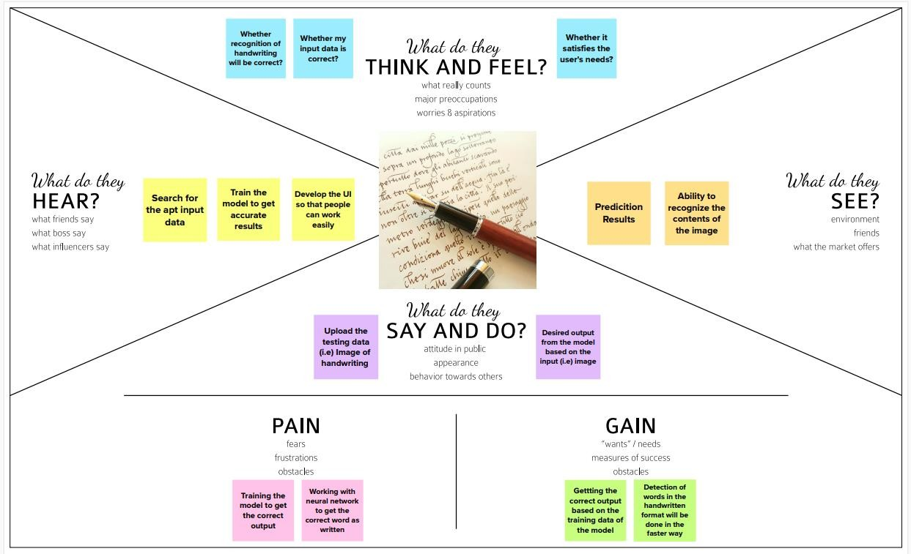
Ideation Phase Empathize & Discover
Date | 10 September 2022
Team ID | PNT2022TMID45157
Project Name | Project – A Novel method for handwritten digit recognition system
Maximum Marks | 4 Marks
A Novel method for handwritten digit recognition system:

